Slide 1

Automated Face Recognition Using Deep Neural Networks Produces Robust Primate Social Networks and Sociality Measures BHOOMIKA REDDY MURALIDHAR 700756473

Slide 2
MOTIVATION
Long-term video archives crucial for studying animal sociality
Manual coding of behavioral data becoming increasingly difficult to scale
Need for automated methods to analyze large-scale video datasets

Slide 3
PROBLEM STATEMENT
Challenges in accurately capturing and analyzing primate social interactions from video data
Difficulty in choosing appropriate temporal windows for defining social associations
Potential biases from human-operated cameras and varying data collection methods

Slide 4
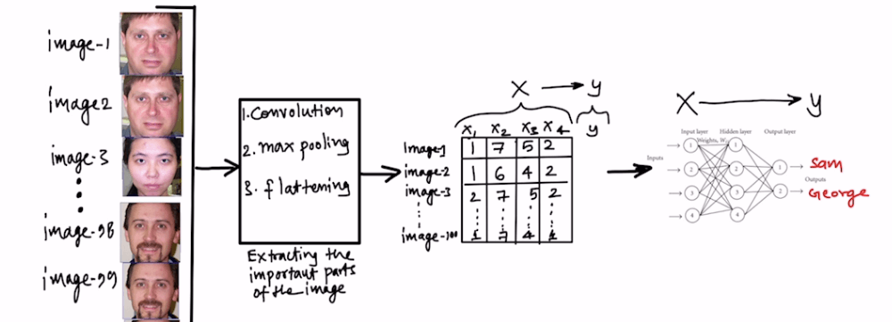
OBJECTIVES
Investigate how aggregation rate affects social behavior estimates
Examine stability and repeatability of individual-level measures across years
Model demographic and life-history variables related to social behavior variation

Slide 5
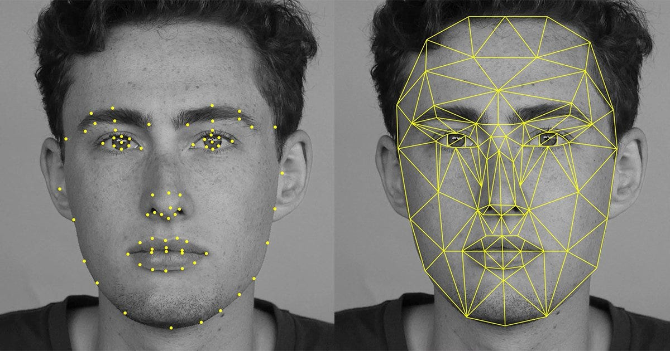
CONTRIBUTION
Application of deep learning face recognition to generate chimpanzee association networks
Analysis of 17 years of video archive from Bossou, Guinea
Examination of trade-offs in using face recognition for social network analysis

Slide 6
RESULTS
Different aggregation rates capture different association patterns
Individual-level network-derived traits highly repeatable over time
No reliable effects of age and sex on social behavior
Stable individual estimates of gregariousness despite population decline

Slide 7
CRITICAL ANALYSIS
Automated framework shows potential for large-scale, low-cost, reproducible studies
Method reliability demonstrated through consistent individual-level patterns
Importance of choosing appropriate aggregation rates to balance error types
Limitations: potential biases from human-operated cameras, challenges in wild settings

Slide 8
REFERENCES
Schofield, D. P., et al. (2023). Automated face recognition using deep neural networks produces robust primate social networks and sociality measures. Methods in Ecology and Evolution.

Slide 9
THANK YOU
Bhoomika Reddy Muralidhar
700756473
BXM64730@UCMO.EDU

